Slide 1


Monetary Navigator
7151CEM – Computing Individual Research Project
Pooja Thota (13086941)
Guided by
Manik Hapsara

Slide 2
Introduction
Background
Small, medium – sized, and micro-enterprises (SMMEs) are recognized as socioeconomic growth drivers in both developed and developing economies due to their substantial involvement in job creation, GDP growth, entrepreneurship, and innovation.
Small and medium-sized businesses confront a variety of issues, with "poor financial management" being cited as one of the leading causes of business failure among SMMEs.
The problem of poor performance among SMMEs has spread throughout the world, piqued the interest of industry participants.
And also, many of the SMMEs are still maintaining accounting books and ledgers for financial management.
The practice of financial management was operationalized utilizing four financial management constructs: working capital management, cash flow management, financial reporting, and asset management.

Slide 3
Introduction
Objectives of the Research
The objective of the research is to help the small, medium – sized, and micro-enterprises (SMMEs) which are facing issues in economic management. This report helps the enterprises in generating the cashflow statements, profit and loss statements and balance sheets.

Slide 4
Relevant Existing Studies
As per the report published by (1990, Royce L and Hal) key position holders, executives, and managers of small enterprises are advised by Royce (1990) to "use this sort of information as a strategic management resource and not only as a historical resource.“
Xero is an existing application that includes automatic bank feeds, invoicing, accounts payable, expense claims, fixed asset depreciation, purchase orders, bank reconciliations, and basic business and management reporting.

Slide 5
Overview of the Project
This project will enhance the financial planning processes of small, medium-sized, and micro-enterprises (SMMEs).
This application can accurately and quickly analyze massive amounts of financial data. By automating the consolidation of financial data from diverse sources, this will guarantee accurate reporting in a timely manner.
This application can greatly increase productivity and efficiency by application financial procedures and automating repetitive tasks.
By doing so, manual errors will be decreased, time will be saved, and finance teams will be able to concentrate on strategic projects rather than mundane administrative tasks.

Slide 6
Overview of the Project
IFRS Vs GAAP
IFRS accounting standard is used in this project.
IFRS (International Financial Reporting Standards) is more extensively used worldwide and is better for firms that operate in various countries.
GAAP (Generally Accepted Accounting Principles) is more focused on the United States and is better for companies that exclusively operate in the United States.
Any reversal of inventory is banned under GAAP once it has been written down.
A write-down of inventory under IFRS can be reversed in future periods if certain criteria are met.

Slide 7
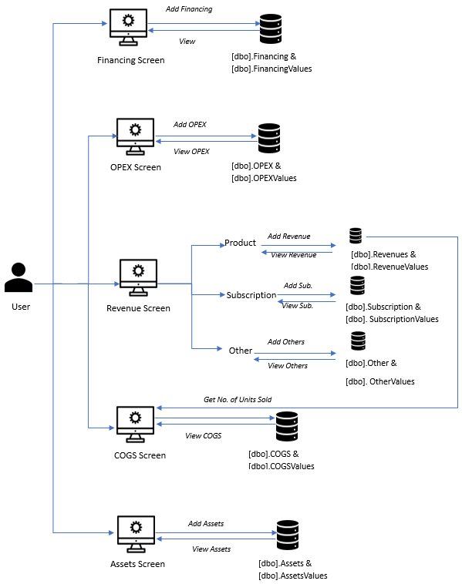
Project Flow

Slide 8
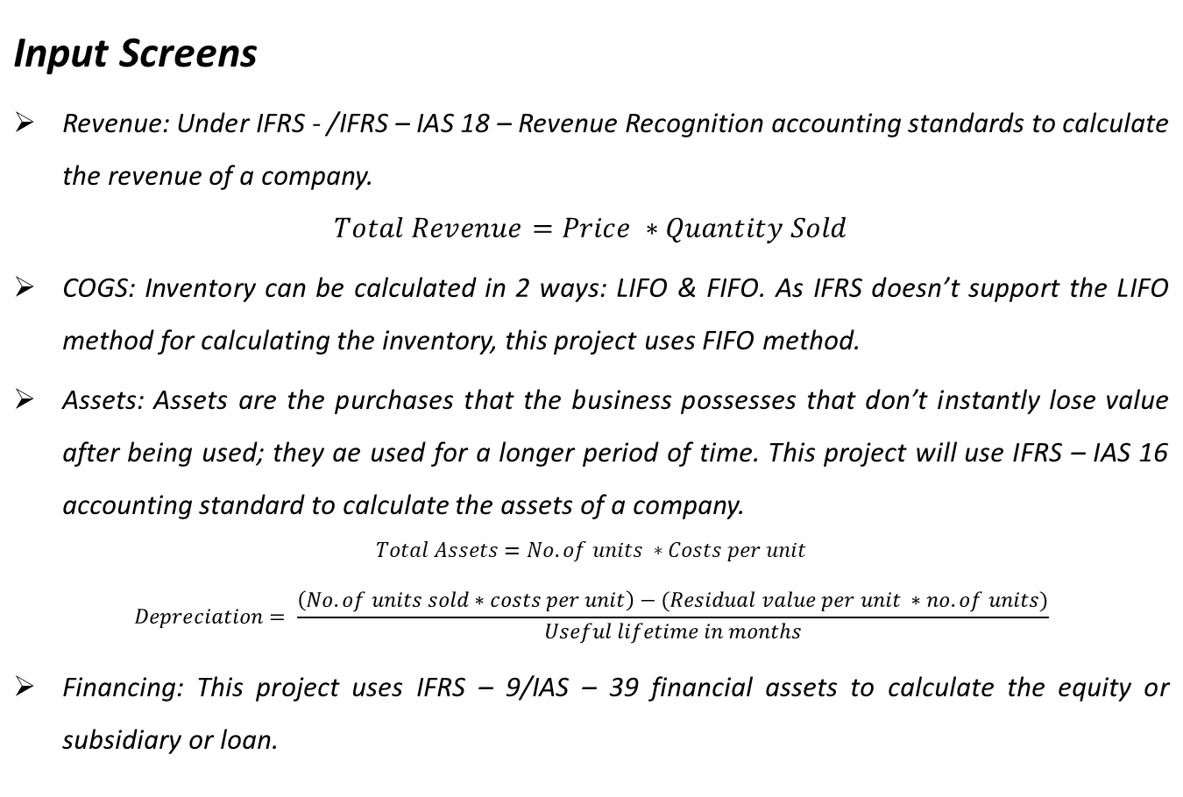
Methodology

Slide 9
Methodology
Output Screens
Income Statement/ Profit & Loss Statement: The income statement in the application will provides the company with insights into company’s revenues and various cost categories while providing an overview of all the income and expenses that business has incurred over a given time period and determining whether the companies are profitable or not.
Balance Sheet: Under IFRS, a statement of financial status with subsets of shareholders' assets, liabilities, and equity is referred to as a categorized balance sheet. This improves our understanding of the financial situation.
Cash Flow Statement: Under IFRS – IAS 7 the cash flow displays every line-by-line cash inflow and outflow that you have included in your financial plan, both on a monthly and annual basis.

Slide 10
Advantages
Helps the companies in improving and understanding their financial plan.
Financial statements, calculated automatically based on the 5 – year input in the customisable financial model.
Decision making for the management.
Reporting, both internally to the management of the startup, but also to the shareholders and investors on a monthly or quarterly basis.
With the innovative algorithm it guides the company towards a professional forecast.
simple to use and does not require any financial background or experience.

Slide 11
Conclusion
Financial planning tool which can be used to create financial projections for SMMEs.
Once data and assumptions have been inputted the tool can provide forward looking integrated balance sheet, profit and loss account and cash-flow statements and charts, along with sector specific benchmarking analysis.
As compared Xero, an existing application, this project will forecast for 5 years on monthly basis, which is not possible in Xero.

Slide 12
References
Potts, A. J. (1992). [George Washington University doctoral dissertation] A study of small business success and failure rates with the use or non-use of accounting information.
Royce L. Abrahamson and Hal B. Pickle, "Small Business Management," 1990. USA: John Wiley and Son
Small Enterprise Development Programme - Integrated Strategies for Small Enterprise Development, International Labor Organization (1992). Policy document. ILO, Geneva, Switzerland.
Revenue – the value of all sales of good and services recognized by a company in a period by CFI Team in (https://corporatefinanceinstitute.com/resources/accounting/revenue/) Corporate Finance Institute, September 2019
IFRS 15 – Revenue from contracts with customers published by Deloitte in (https://www.iasplus.com/en-gb/standards/ifrs-en-gb/ifrs15) UK accounting plus
IAS 18 – Revenue Recognition published by Deloitte in (https://www.iasplus.com/engb/standards/ias/ias18) UK accounting plus

Slide 13


Slide 14
    Thank
    You

